Slide 1
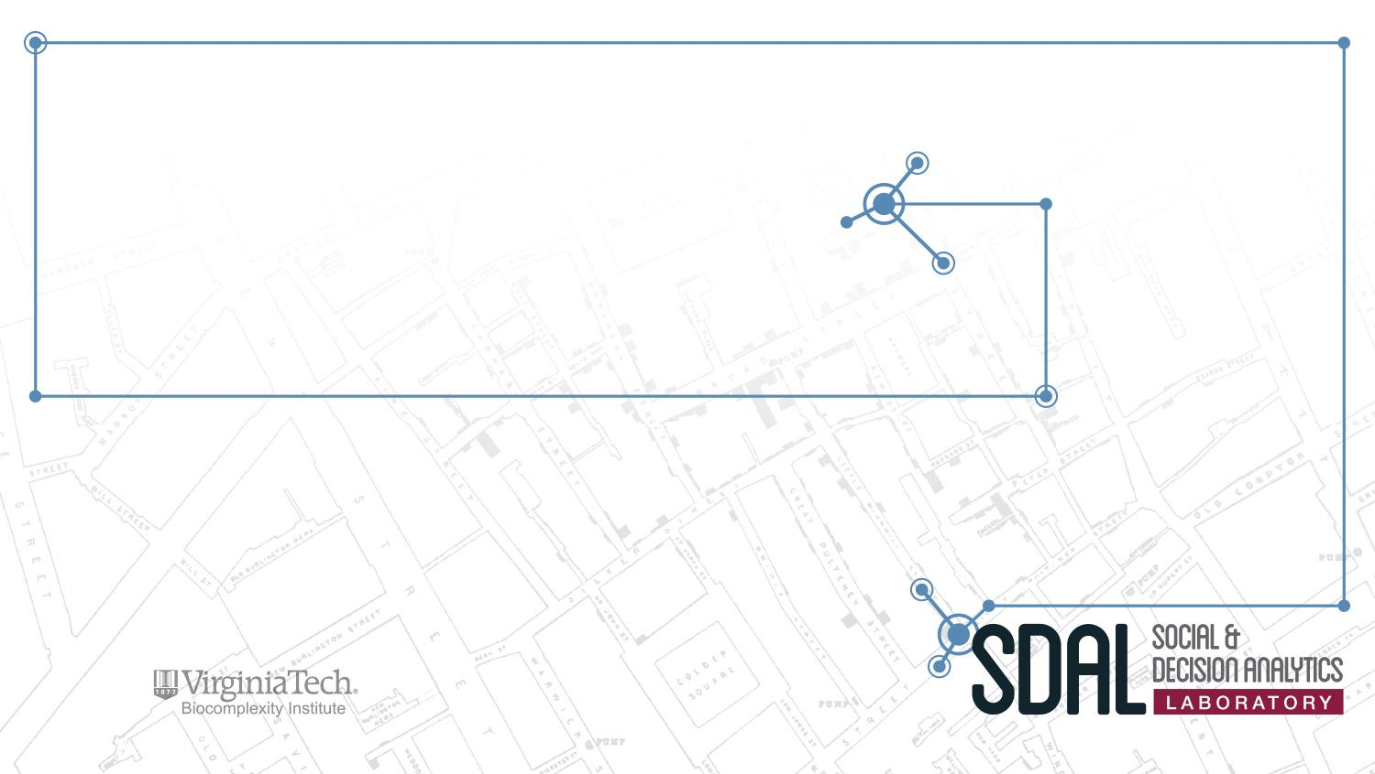

Measuring the Impact and Scope of Open Source Software (OSS) Innovation
PI: Gizem Korkmaz
Presenting Team: José Bayoán Santiago Calderón, Daniel Chen, Eirik Iversen, Hannah Brinkley, Keren Chen
Sponsor: Carol Robbins, National Science Foundation (NSF)
National Center for Science and Engineering Statistics (NCSES)

Slide 2
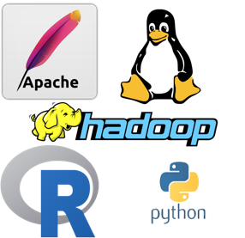
Project Overview
Current NCSES and other economic indicators do not measure the value of open source software (OSS) outside the business sector:
  Contribution of people from universities, government research institutions, nonprofits, and individuals
Importance of quantifying coding impact in the scientific community
  Citations are used to measure the impact of patents and publications used to estimate research outputs
The goal is to test the feasibility and to develop methods to measure the impact and scope of OSS
Identify data sources and variables to measure attributes and economic value.
Notes:
We are analyzing the value of a scientific and artistic contribution that is not being accurately measured by current tools such as patents and citations.
We are developing a framework, methodology, identifying data sources and variables that are an improvement in this endeavor.

Slide 3
Research Questions
How much open source software is in use? (stock measure)
  Active completed projects, downloads
How much is created each year? (flow measure)
  New projects (annual and cumulative), lines of code, commits, man-hours
What types (categories) can be identified?
Who creates it?
  Sectors: Business, Government, Academia, Households, Nonprofits, Foreign
Who benefits from its development?
  Users: Downloads, citations, other developers (reverse dependencies)
What methods can we use to estimate cost and economic value of open source software?
  Software cost estimation, network analysis
Notes:
Our research questions are pretty intuitive:
How much of it is out there (i.e., the stock)? Meaning projects with a production-ready release for the current environment.
How much is being developed every year (i.e., the flow)? We can identify this by various measures of activity.
What kind of projects are being developed?
...

Slide 4
OSS Definition
OSS is a computer software with its source code made available with a license in which the copyright holder provides the rights to study, change, and distribute the software to anyone and for any purpose.
OSS is a philosophical framework for how users should interact with software. It considers the rights to use, modify, and distribute it and under what conditions.
Operationalized
  Open Source Initiative (OSI)-Approved License
  Production Ready Release for Current Ecosystem
‹#›
Notes:
Definition of OSS

Slide 5
Core Concepts
Current Focus:
  OSS universe: how much is out there?
  Profile of contributors (affiliations and sectors)
  Contribution over time (rate of development)
  Depreciation analysis
Strategy to capture OSS universe:
  Three categories:
    Major Projects (e.g., Mozilla, Apache)
    Programming Languages (e.g., R and Python)
    Packages (e.g., ggplot2, Pandas)
‹#›
Notes:
What is being produced, by whom, where, when, and how?

Slide 6
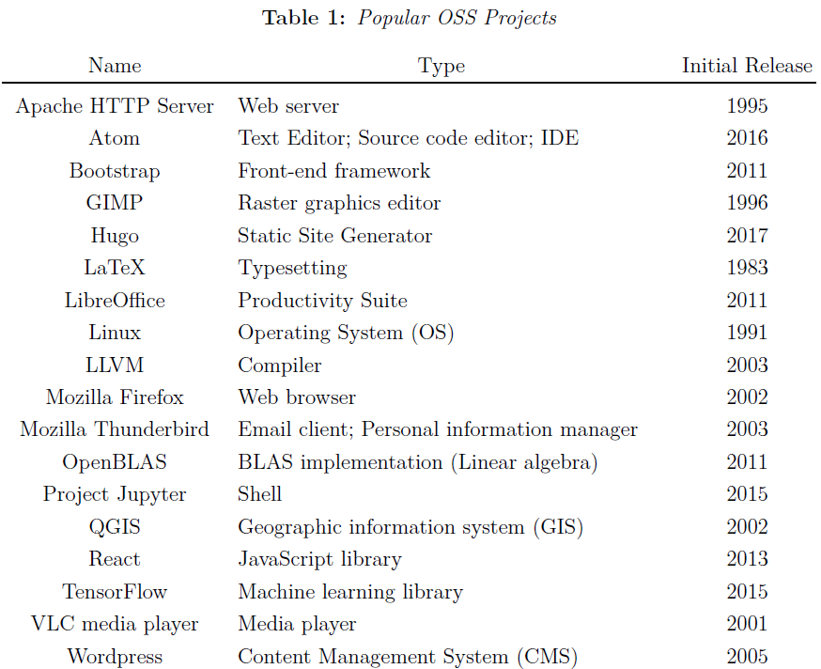
Notes:
major OSS languages
Hannah: witty comments on why these are great

Slide 7
Core Concepts
Strategy to capture OSS universe:
  Three categories:
    Major Projects (e.g., Mozilla, Apache)
    Programming Languages (e.g., R and Python)
    Packages (e.g., ggplot2, Pandas)
‹#›
Notes:
Hannah
What is being produced, by whom, where, when, and how?

Slide 8
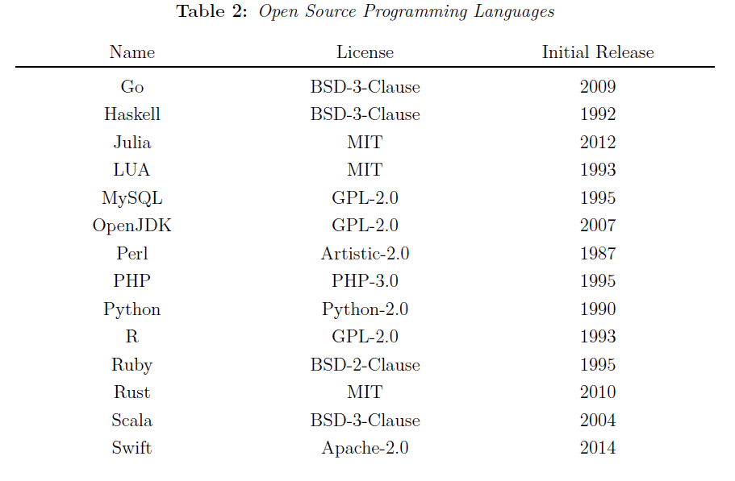
Notes:
Hannah

Slide 9
Core Concepts
Strategy to capture OSS universe:
  Three categories:
    Major Projects (e.g., Mozilla, Apache)
    Programming Languages (e.g., R and Python)
    Packages (e.g., ggplot2, Pandas)
‹#›
Notes:
Hannah
Added functionality

Slide 10
Strategy
Registry
Manifest File
Repository
Common supported package managers
Contains basic information about each package
Contains Metadata
  Author, license, version, dependencies, etc.
Some registries parse this information while others do not.
Information about the author, maintainer, license, package status, etc.
When Github is used
  Additional information is provided
    Contributions
    Contributors
‹#›

Slide 11
Data Collection
Usual Tools
  GitHub API
  Travis C.I. API
  Licensee (Ruby Gem)
Tables
  basic_information: (name, repository, status)
  licenses: (name, license type)
  authors: (name, entity, role, identity)
  dependencies: (name, release, dependency)
  contributors: (name, entity, lines of code (LoC), start_date, end_date)

Slide 12
Data Profiling
After examining 30+ different languages / package managers / registries we chose a subset most suitable for this project (see full inventory list).
Language | Package Manager | All packages | Production Ready | OSI-approved
R | CRAN | 12,614 | 12,163 | 12,321
Python | PyPi | 143,047 | 10,423 | 7,392* (from PR)
Julia | Pkg.jl | 2,040 | 1,324 | 2,000
JavaScript | CDNJS | 3,367 | --- | 2,731
Code.gov | --- | 4,866 | --- | 4,866
‹#›
Notes:
1 started w/ 30+ …
2 created the inventory table w/ info about each pkg managers such as… (eg. size, talk about the table briefly)
3 selected these 4 commonly used langs, will collect the info about all pkgs in these 4 langs, (and u can see the #pkgs in 3rd column)
we will collect development activity information, contributors, etc.

Slide 13
Data Collection
After examining 30+ different languages / package managers / registries we chose a subset most suitable for this project (see full inventory list).
Language | Package Manager | Number of packages (OSI & production ready) | on Github
R | CRAN | 11,886 | 3,049
Python | PyPi | 7,392 | 4,605
Julia | Pkg.jl | 1,324 | 1,324
JavaScript | CDNJS | 3,367 | 3,274
‹#›
Notes:
1 started w/ 30+ …
2 created the inventory table w/ info about each pkg managers such as… (eg. size, talk about the table briefly)
3 selected these 4 commonly used langs, will collect the info about all pkgs in these 4 langs, (and u can see the #pkgs in 3rd column)
we will collect development activity information, contributors, etc.

Slide 14
Data Collection
Variables on Github:
contributors: author credits, organizations, emails, locations, followers
timestamp
additions
deletions
commits
stars
Variables on CRAN:
licence, authors, roles, version, dependency, lines of code (mirrors)
Variables on Cranlogs (Depsy):
downloads

Slide 15
Next Steps
Project Code (Github)
Validate Data
Analysis
Collect the contributions and contributors.
For the latest release
For the top 100 contributors by commits
Timestamped Lines of Code (LoC)
Profile of contributors
License
Package status
  Continuous Integration (C.I.)
  Maintainers
  Activity
Estimate cost and value (by organization, sector, category, language)
Network analysis of contributors and packages
Dependency charts

